Slide 1





CHRISTINA, BRIA, DEVANSH, KEEANA

Slide 2






WEB VERSION
JUST LAUNCHED
APPLE STORE
COMING SOON
OUR PLATFORMS
GOOGLE PLAY
COMING SOON

Slide 3
INTEREST-BASED
Connects students based on activities they want to do, but not alone
WHAT IS ALIKE?
UNCONVENTIONAL
Flipping the current trend of meeting people
CONNECTIONS
We're not a dating app, but we can't control what happens after people match

Slide 4
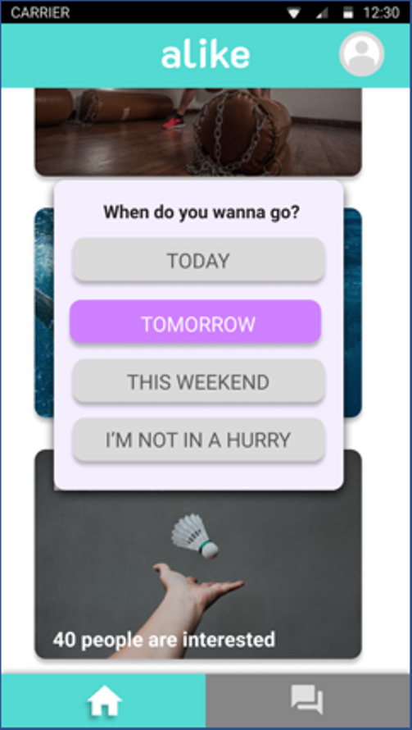
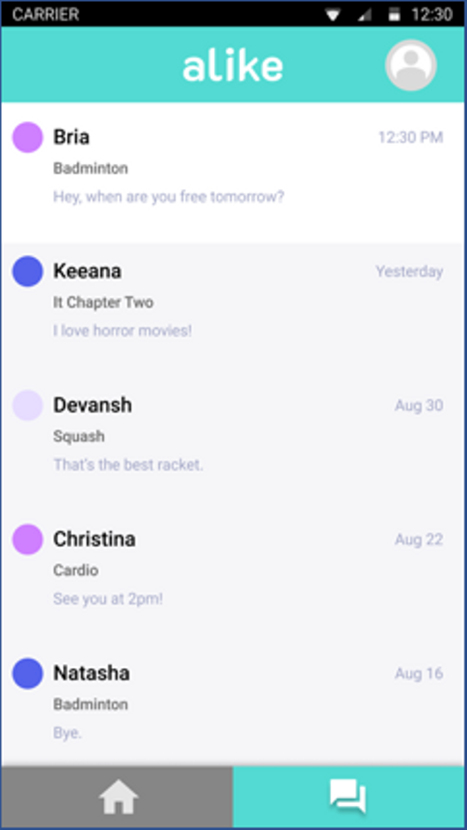
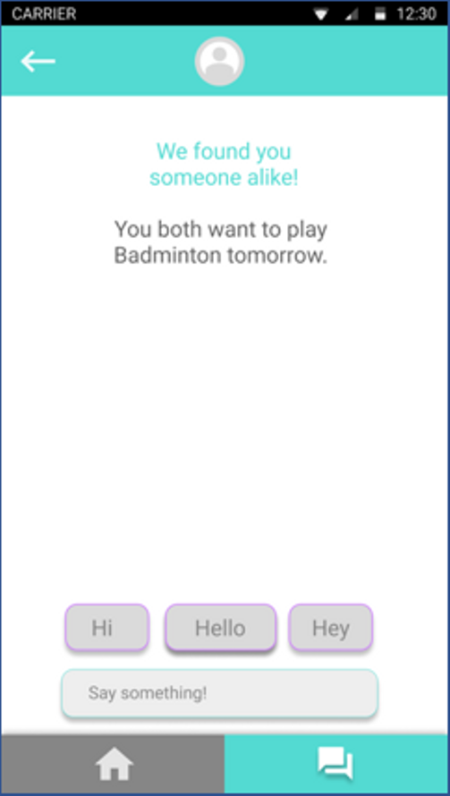

Slide 5



IMMEDIATE PLAN
ONBOARD DIFFERENT ACTIVITY PROVIDERS
EXCLUSIVE TO UNDERGRADS
UNIVERSITY PROMOTION
SKYZONE, BATTLE AXE

Slide 6

HOW IT WORKS
SEND 10 MESSAGES TO UNLOCK PROFILE DETAILS
COMPLETE THE PLANNED ACTIVITY
UNIVERSITY LOGIN API
SELECT AN ACTIVITY YOU WANT TO DO
GET INSTANTLY MATCHED

Slide 7


Slide 8

FUTURE PLAN
DEVELOP AN IN-APP HEAT MAP TO DISPLAY POPULAR ACTIVITIES NEARBY
ALLOW DIRECT BOOKINGS AND RESERVATIONS FROM OUR PLATFORM
INTEGRATE WITH COMPANIES LIKE GROUPON
OPEN THE NETWORK TO EVERYONE, BUT MAINTAIN EXCLUSIVITY ON CAMPUS

Slide 9
ANY QUESTIONS?

